Slide 1


BitTitan for Partners
INSERT LOGO
MigrationWiz & PowerSyncPro

Slide 2
About BitTitan
INSERT LOGO
46K
28M
188
PARTNERS
USERS
COUNTRIES
17 years ago, we started building software to help IT services providers drive cloud adoption.
Today, our industry-leading platform helps IT professionals assess, deploy, and manage cloud solutions with greater profitability.

Slide 3
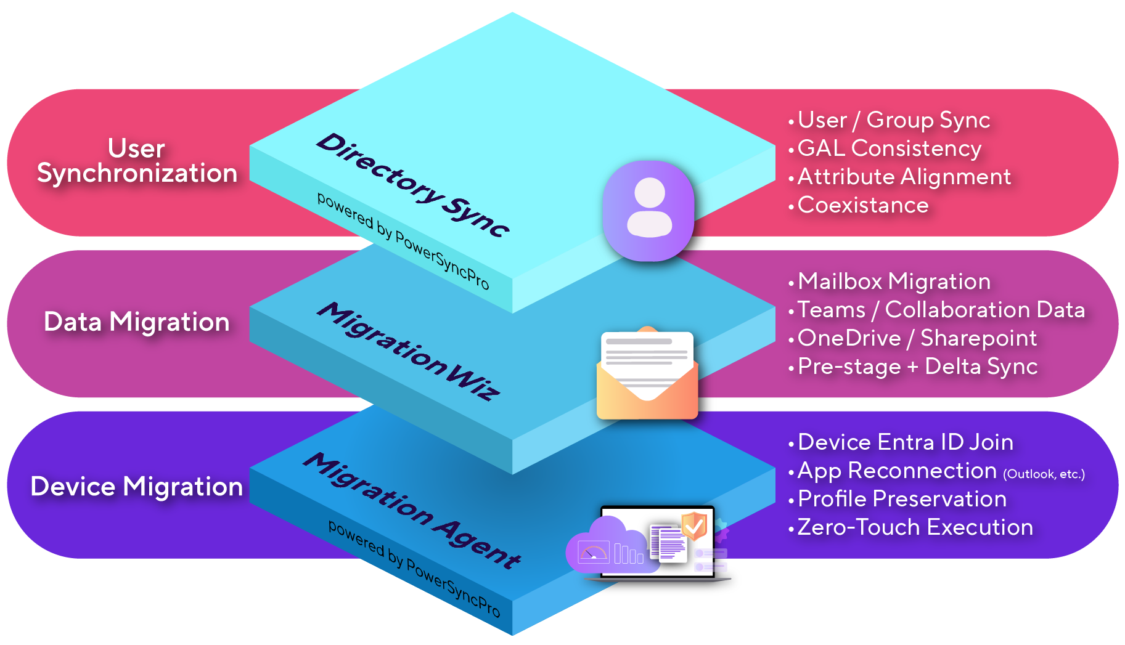
MigrationWiz & PowerSyncPro stack
INSERT LOGO
NEW - 2026
NEW - 2026

Slide 4

Common Challenges Without BitTitan
INSERT LOGO
Difficult to set up with complex interfaces
Costly professional services required
No transparent pricing
Limited supported scenarios
Hard to access, complex guidance

Slide 5

INSERT LOGO
The BitTitan Difference
1
Easy yet customizable migration experience
Complete tenant migration stack (identity, data & devices)
Free 24/7 support with 24h SLA and public documentation
100% partner focused operating model
2
3
4

Slide 6
Sources & Destinations
INSERT LOGO
Mailboxes
Documents
Personal Archives
Collaboration
Active Directory
Devices
Sources | Exchange Online Exchange 2003/2007+ Gmail IMAP/POP Zimbra 6+ | OneDrive SharePoint Online Google Drive Google Shared Drive Windows File System | Exchange Online Exchange 2007+ Google Vault PST Files | Microsoft Teams Microsoft Teams Chats | Active Directory On-Premises Entra ID Google Workspace | Windows 10 Windows 11
Destinations | Exchange Online Exchange 2010+ Gmail IMAP | OneDrive SharePoint Online Google Drive Google Shared Drive | Exchange Online Exchange 2010+ PST Files | Microsoft Teams Microsoft Teams Chats | Active Directory On-Premises Entra ID | Windows 10 Windows 11
NEW - 2026
NEW - 2026

Slide 7

Increasing Cloud Profitability
INSERT LOGO
Current Revenue Opportunity
(without BitTitan)
Typical Profit Margin:
5 -30%
2
Maintain current pricing and significantly increase profits
50-300%
Profit Margin
Increase
New Profit Margin Opportunity
Increase revenue immediately
Price
Flexibility
Partner Cost of Goods & Services Today
(without BitTitan)
1
Significantly lower fixed costs with BitTitan solutions
3
Offer lower prices while maintaining profitability
90% Reduction in Time
50% Reduction in Cost
5-10x Scale Impact

Slide 8
MigrationWiz
INSERT LOGO

Slide 9
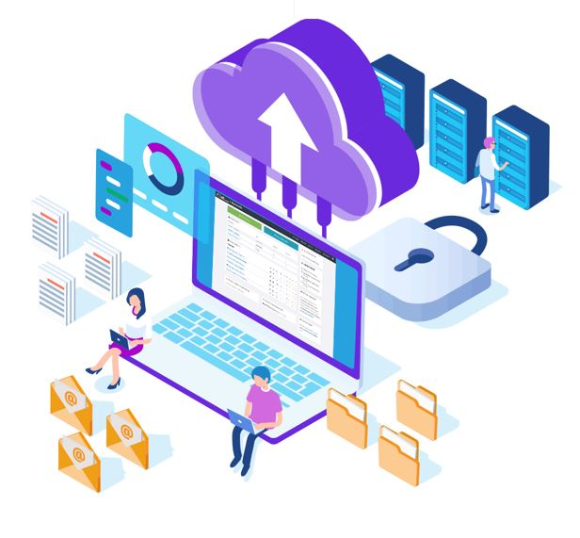
MigrationWiz
SaaS solution for user generated & organizational data
INSERT LOGO
What it delivers
Easy and fast migration of Modern Workplace data
For Microsoft 365, Google Workspace & On-Prem
Cloud onboarding, mergers, acquisitions & divestitures
What it means
Minimize engineers time spent on moving data to increase project profitability

Slide 10
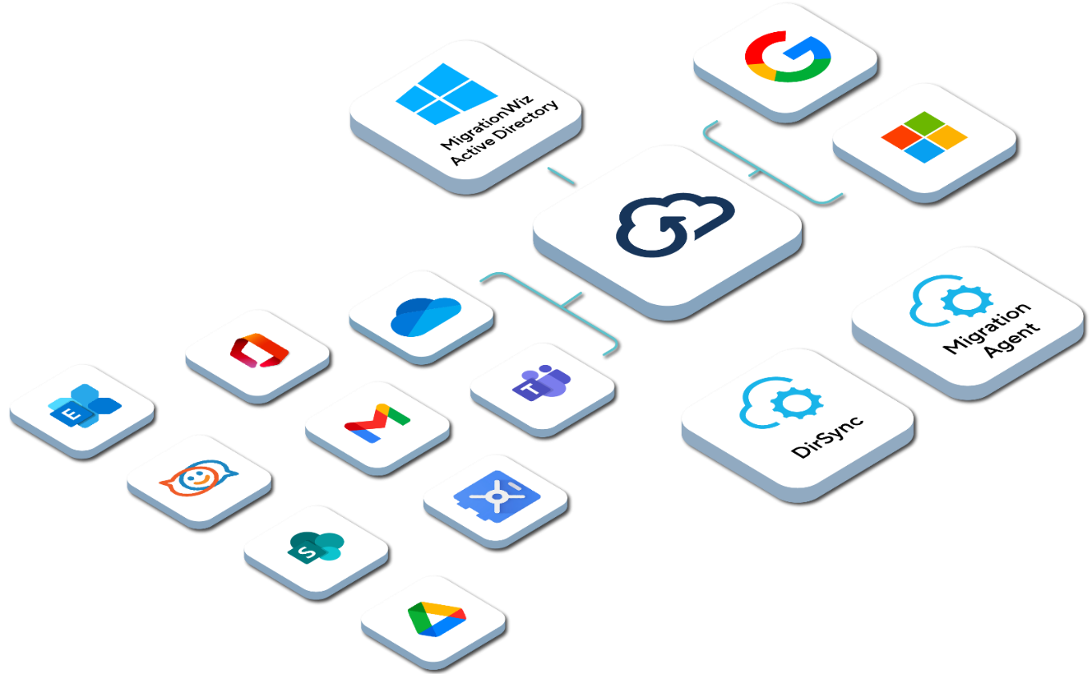
MigrationWiz automates
INSERT LOGO
Mail migration to Microsoft 365 and Gmail
Personal Archive migration to Exchange, Microsoft 365 and Gmail
Document migration to OneDrive, SharePoint and Google Drive
Microsoft Teams to Microsoft Teams migration
Public Folder migration

Slide 11

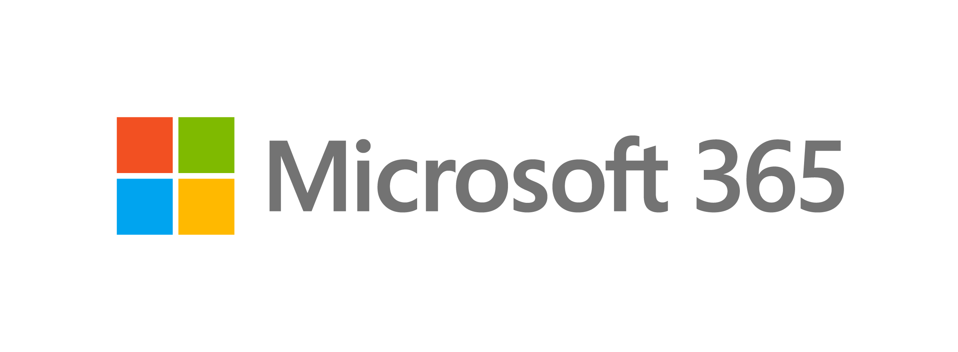





Industry leader for T2T migrations
INSERT LOGO
122+
Countries
45K+
T2T Projects
6M+
Users
Supports the diverse needs of Tenant-to-Tenant scenarios:
Mergers, acquisitions, divestitures
Data sovereignty
Domain name renaming
Multi-tenant consolidation
Empowering collaboration for remote work
Benefits of MigrationWiz
Minimal downtime + Control over cutover + Data loss prevention + Automatic device reconfiguration
Workloads to migrate

Slide 12
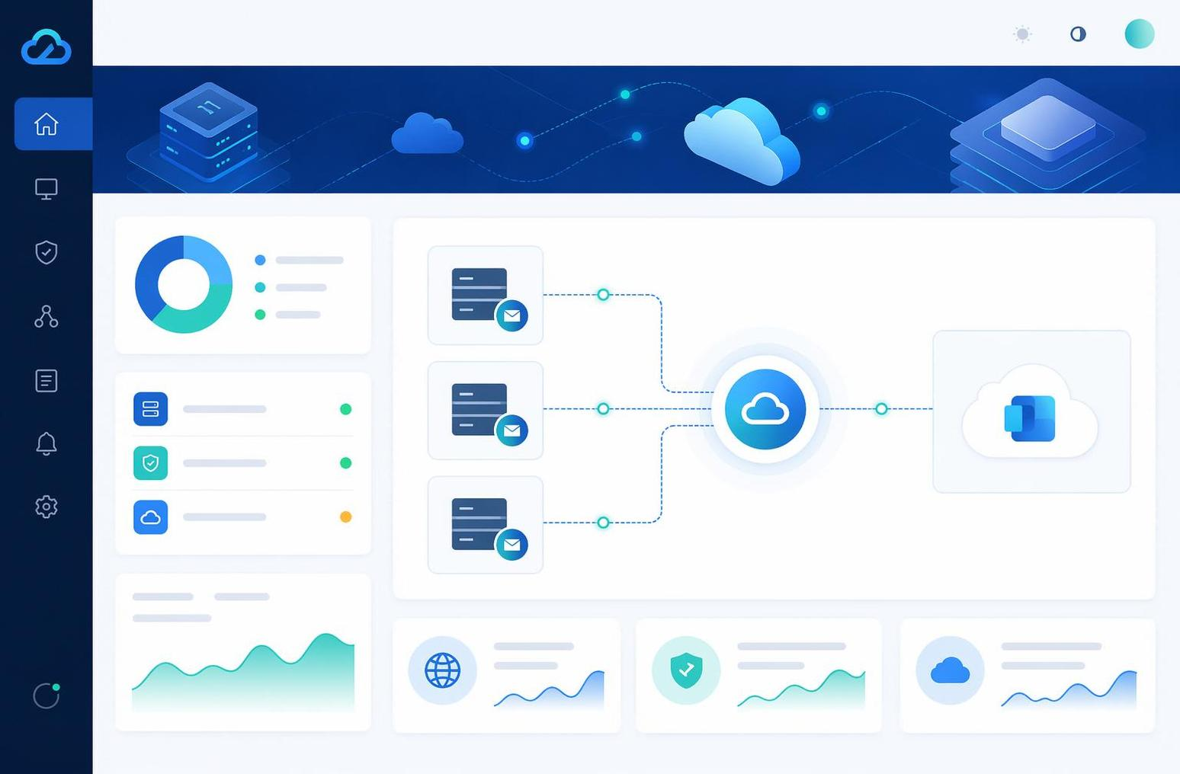
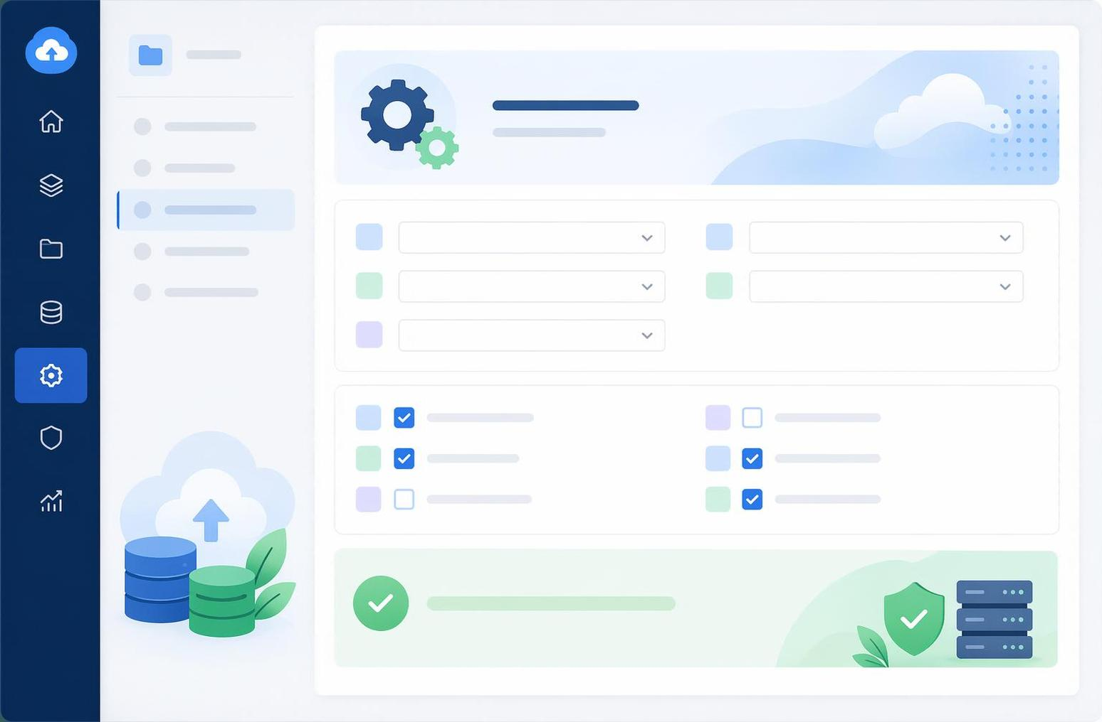
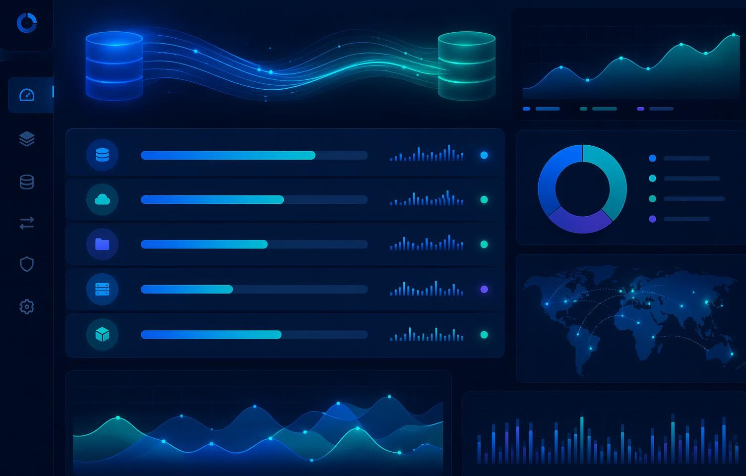
MigrationWiz experience
INSERT LOGO
3 Steps
Connect, configure, and monitor
100%
Cloud-based, no infrastructure needed
24/7
Real-time monitoring and support
Connect
Configure
Monitor

Slide 13
PowerSyncPro
Directory Sync
INSERT LOGO

Slide 14

PowerSyncPro Directory Sync
Common identity migration requirements
INSERT LOGO
What partners have to deliver
Identity coexistence
Staged or phased migration
Both environments remain operational
Passwords aligned across directories
Advanced attribute mapping / transformation
User filtering
Domain changes

Slide 15
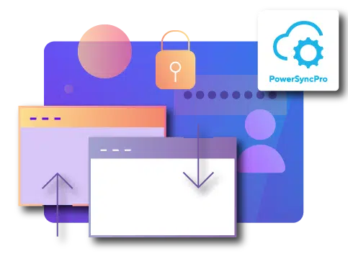
PowerSyncPro Directory Sync
The Identity Synchronization Engine
INSERT LOGO
What it delivers
Supports Active Directory, Entra ID, and Google Workspace
Synchronizes users, groups, contacts & guests
Password sync & attributes including SID history
What it means
Simplify complex and challenging identity migrations to facilitate complete Microsoft 365 migrations

Slide 16
Active Directory Solution Comparison
INSERT LOGO
Capability | PowerSyncPro DirSync | Microsoft Entra ID Connect | Quest On Demand Migration for Active Directory
What It Is | Identity migration and synchronization platform for Active Directory and Entra ID | Directory synchronization utility | Directory migration platform with multiple add-on modules
Primary Function | Directory object migration and identity synchronization | Synchronizes identities from AD to Entra ID | Migrates directory objects between AD environments
Complex granular scoping | ✔ Supported | ✖ Not supported | ✔ Not supported
Identity Synchronization | ✔ PowerSyncPro DirSync provides continuous identity synchronization | ✔ Password and attribute synchronization | Limited. Requires additional configuration
SID History | ✔ Synchronizes SID History | ✖ Not supported | ✔ Supported
Attribute Transformation | ✔ Advanced attribute mapping and transformation | Limited attribute mapping | Limited transformation capabilities
User Filtering | ✔ Flexible filtering for migration and synchronization | Limited filtering | Supported
Directory Support | ✔ Active Directory, Entra ID, and Google Workspace | Active Directory to Entra ID only | Active Directory environments
Deployment Model | Customer-hosted Directory Sync server | On-premises sync server | SaaS platform with supporting agents
Bottom Line | Complete identity syncronization and coexistence solution | Identity synchronization only | Traditional AD migration tooling

Slide 17
PowerSyncPro
Migration Agent
INSERT LOGO

Slide 18

PowerSyncPro Migration Agent
Windows Device Migration Automation
INSERT LOGO
What it delivers
Transitions devices to the new tenant ​
Preserves user profiles, files, and settings ​
Reconnects Outlook, Teams, and OneDrive ​
Eliminates reimaging and manual rebuilds ​
What it means
No desk-side visits or remote connect sessions ​
No intense overnight IT effort during cutover​
No disruption to users ​or business
No “new computer” experience

Slide 19
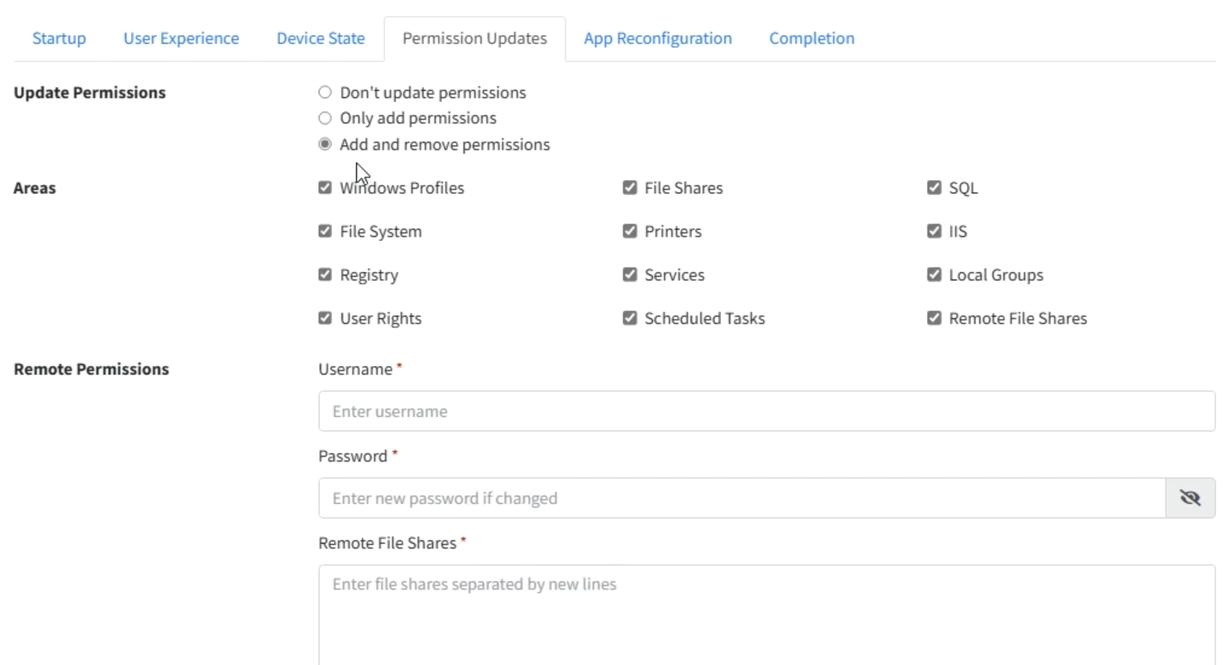
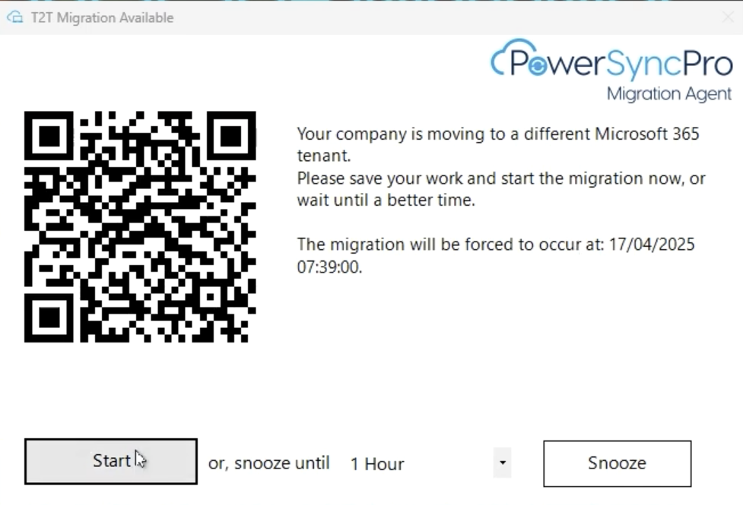
PowerSyncPro Migration Agent
Seamless user experience without reimagining
INSERT LOGO
All needed device migration requirements covered without wiping or re-imaging device
Users have control to schedule their device cutover and
a QR code for more information about the migration

Slide 20
Workstation Solution Comparison
INSERT LOGO
Capability | PowerSyncPro Migration Agent | Quest On Demand Workstation Migration
Strategic Scope | Automated device-to-tenant migration platform for enterprise workstation transitions | Workstation migration capability within Quest migration tooling
Automation Model | Persistent migration agent with centralized orchestration and runbooks | Task-based migration workflow with limited centralized automation
User Experience | Interactive tray notifications with user-controlled migration scheduling | Typically admin-driven migration with limited user interaction
Profile Preservation | Preserves Windows user profiles, files, desktop settings, and application configurations | Preserves Windows user profiles
Microsoft 365 App Readiness | Automatically connects Outlook, Teams, and OneDrive after migration | Microsoft 365 app reconfiguration requires additional steps or licensing
Join State Coverage | Supports transitions across AD, Entra ID, Hybrid, and WORKGROUP devices | Limited join state coverage
Deployment & Scale | MSI deployment via Intune, SCCM, GPO, or other tools. Supports thousands of devices in parallel | Parallel migration possible but concurrency limits may require support adjustments
Visibility & Monitoring | Near real-time dashboard and centralized migration logging | Limited centralized monitoring
Resilience | Agent recovery from environmental interruptions | Limited recovery capabilities
Enterprise Migration Readiness | Designed for large-scale tenant transitions, mergers, and domain consolidations | Designed primarily for workstation transitions within broader Quest migration projects

Slide 21
Licenses & Support
INSERT LOGO

Slide 22

MigrationWiz licensing
Data migrations
INSERT LOGO
SKU Name | Included | Limitations
User Migration Bundle | Mailbox / Mailbox Archive / Personal Documents / Teams Chats | Unlimited data for 1 user / license
Mailbox | Mailbox | 50 GB / mailbox / license
Public Folders | Exchange Public Folder | 10 GB / top level folder / license
Collaboration | Teams / Channels / Conversations / Documents (Files tab) / Memberships | 100 GB / team / license
Shared Documents 50GB | SharePoint Online document libraries / Google Shared Drives | 50 GB / SPO doc library / license 50 GB / G Shared Drive / license
Shared Documents 100GB | SharePoint Online document libraries / Google Shared Drives | 100 GB / SPO doc library / license 100 GB / G Shared Drive / license
Tenant Migration Bundle | 1x User Migration Bundle + 1x Flex license | Flex license can be used as Collaboration or Shared Documents 100GB license
All licenses are valid for 12 months from date of purchase

Slide 23
Tenant Migration Bundle
Example: 100-user project using a mix of Tenant Migration Bundles and User Migration Bundles.
INSERT LOGO
TENANT MIGRATION BUNDLES (30x)
USER MIGRATION BUNDLES (70x)
30 user Mailboxes
Each Tenant Migration Bundle includes User Migration Bundle and a Flex license.
Amount of Tenant Migration Bundles is based on combined count of SharePoint Online Document Libraries and Teams.
70 user Mailboxes
In this project we needed 30 Tenant Migration Bundles. For rest of the users we choose the User Migration Bundle.
30 user OneDrives
70 user OneDrives
20 Teams
10 SPO Document Libraries
Flex License
Can be used for either Teams or SharePoint Online data — up to 100 GB per license.
1x license required for each Team or SharePoint Online document library (100GB).
User Migration Bundle
Covers mailboxes and files at the user level — with no data limit.
Includes:
Exchange Online & Exchange Online Archive
OneDrive for Business
Teams Chats

Slide 24
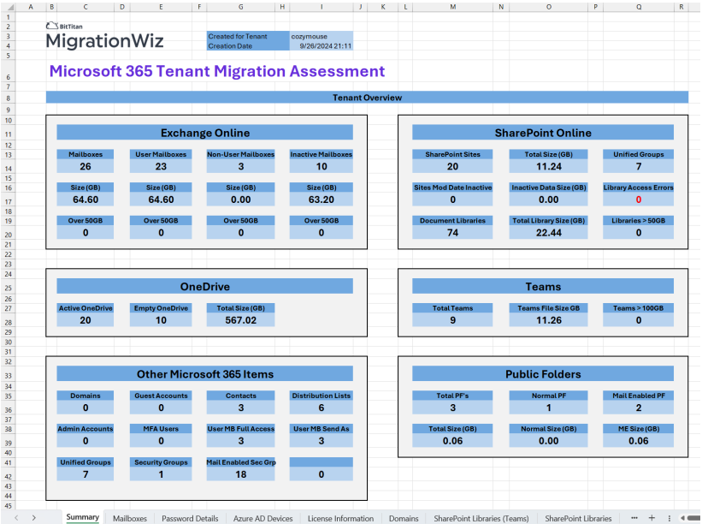
INSERT LOGO
MigrationWiz Assessment Tool
Available free for Microsoft 365 & Google Workspace tenants

Slide 25
INSERT LOGO
PowerSyncPro licensing
Identity & device migrations
SKU Name | Included | Limitations
PowerSyncPro Directory Sync | Sync users and groups, between AD and Entra ID, and from Google Workspace | 1 User / license
PowerSyncPro Migration Agent | Migrate Windows devices between AD, Entra ID, and workgroup | 1 Device / license
PowerSyncPro Bundle | 1x PowerSyncPro Directory Sync + 1x PowerSyncPro Migration Agent license | 1 User + 1 Device / license
PowerSyncPro Quick Start | Up to 7 hours of live phone or screenshare technical support on setup | Project specific
PowerSyncPro Advanced Support | Live phone or screenshare technical support on issues and direct escalation path | Project specific
All licenses are valid for 12 months from date of purchase

Slide 26
Customer Success Offering
INSERT LOGO
Customer Support
Knowledge Base
Customer Enablement
Free 24/7 global support
Same day response
95% customer satisfaction
90+ migration guides
1000+ help center articles
Publicly available
In-product guided assistance
Project configuration support
Enterprise options available

Slide 27
INSERT LOGO
Thank you!
Partner Name Contact:
[Insert Partner Name Sales Rep]
[Insert Email]
[Insert Phone]

